Slide 1
Final Project
Boolean Gurus

Slide 2
Overview
Planning stages
How the application developed
Technical aspects
Functionalities for different types users
Looking Back
Future Plans

Slide 3
The Planning Stages
Wrote out everything that our app would need to do to ensure a positive user experience.
Looked at these requirements and measured them in importance:
Crucial for app
Very important
Great to have

Slide 4

The Planning Stages (cont.)
Broke these tasks into different sections:
UI
Data
Controller
User Functions
Instructor Functions
Admin Functions

Slide 5
What Has Worked Thus Far
Assignment of work for projects has been consistent throughout year
Members pick and choose what they are comfortable with
Allows everyone to work off their strengths
Let others know progress, issues, completeness, etc.

Slide 6
Tracking Progress
Due to the complexity of this project compared to others, a different tracking system was created:
𝙓 = nonfunctional or nonexistent
🏗 = functional but needs future development
✓ = Functional and satisfies all needs

Slide 7
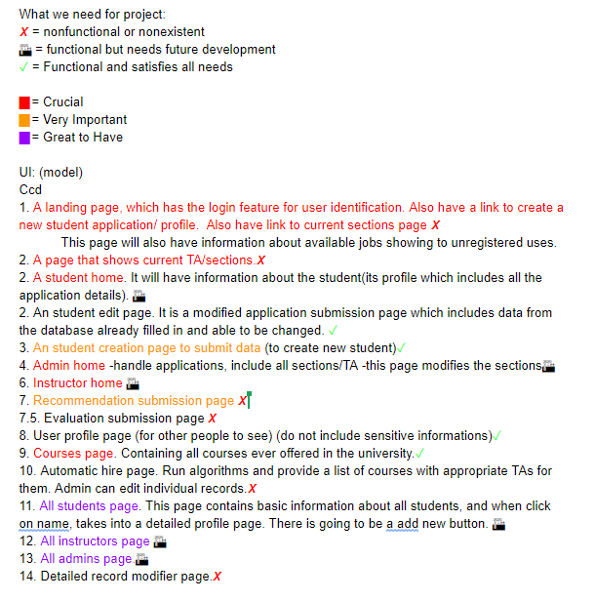
Tracking Progress (cont.)
This early screengrab shows insight
Note the color-coding denoting importance
Also, note the symbols marking completion

Slide 8
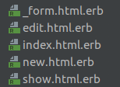
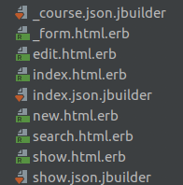
Building of the Application
Started with very basic functionality
New, Show, Edit, Index
Few security checks
Basic tables
Grew over time into more developed and fleshed out project
Json builders
External keys
Search functions

Slide 9
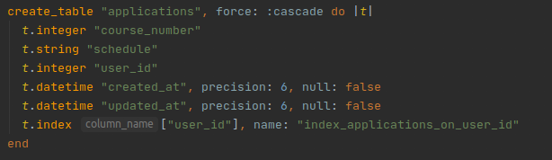
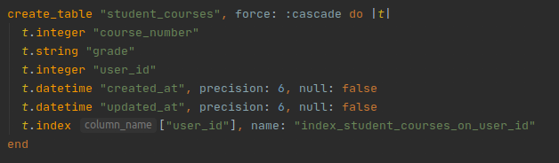
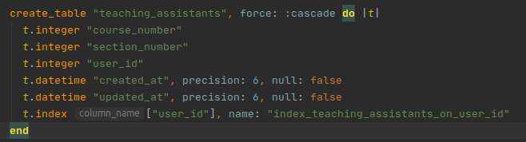
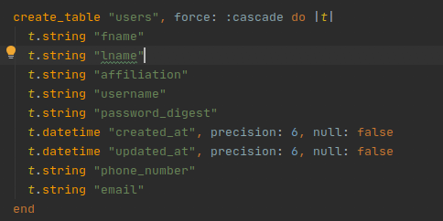
Schemas
Applications Student Courses
TA’s Users

Slide 10
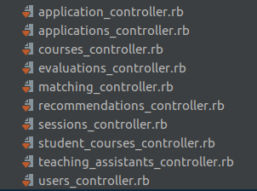
Controllers
The application utilized many controllers, about one for each table and then a few more.

Slide 11
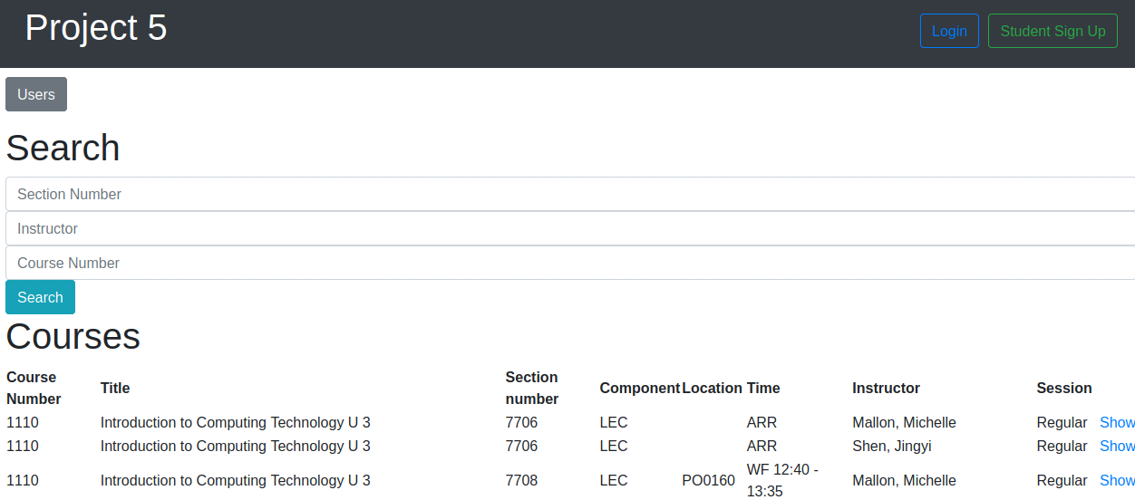
General Functionality
All users and visitors on the site are able to search and examine different courses and user accounts.

Slide 12

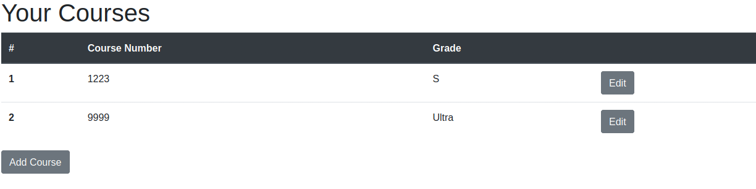
User Specific Functionality
Limited View
Only able to see/edit own data
Apply to TA positions
List relevant courses/grades

Slide 13
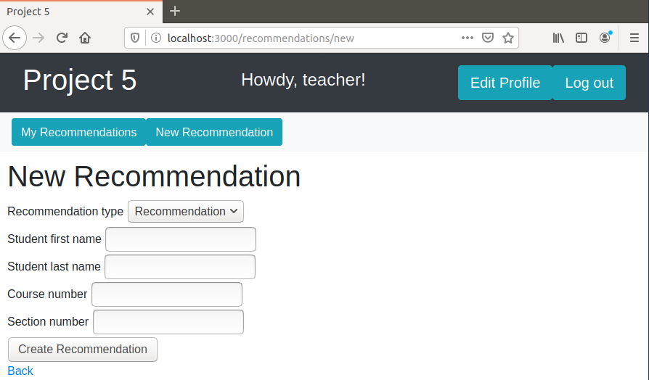
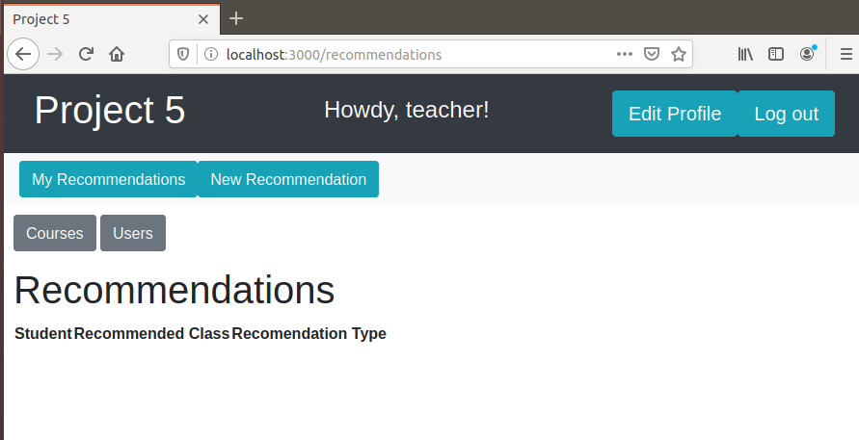
Instructor Specific Functionality
Sees course & user information
Can create and view recommendations

Slide 14
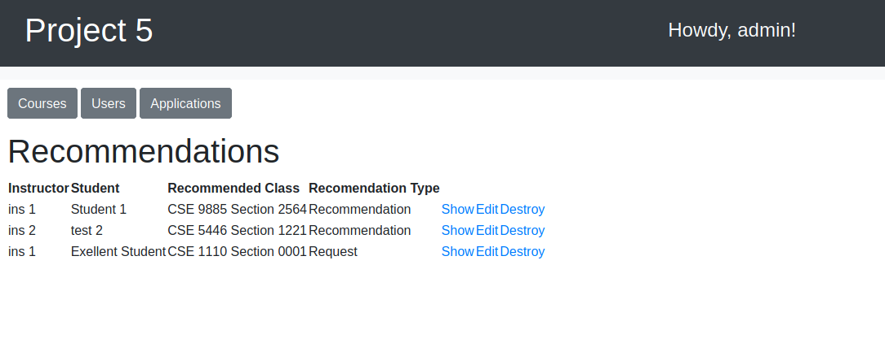
Admin Specific View and Functionality
The ability to create and destroy users in the database
Only admins can create admins and professors
This provides more security than allowing students to sign up as higher ranks
Access applications and recommendations

Slide 15
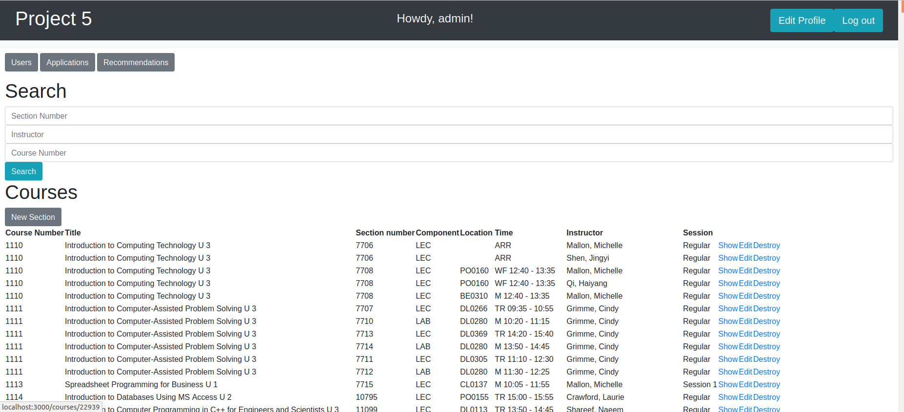
Admin Homepage

Slide 16
TA Matching Algorithm

Slide 17
Student Demo

Slide 18
What Was Difficult?
Early mistakes make for confusing later errors
Issues with gems had us short-staffed
GitHub went down for some team members on release day

Slide 19
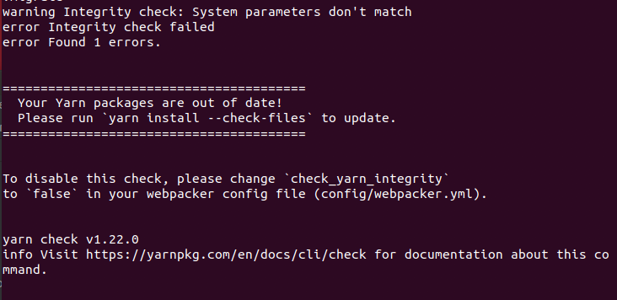
Problems Encountered
Development log issues
Merge conflicts
Issues with the Yarn gem
Changing data structures

Slide 20
What Would We Change Next Time?
More planning for the data
Changing/Incomplete table cause additional work down the line
Start Earlier
Give time for possible environmental issues

Slide 21
Plans for Future Development
Additional security
Hashing passwords
Evaluations
Make UI less repetitive

